Slide 1
DATA ANALYSIS
BY JUSTIN BIEBER
RESA-FKA

Slide 2
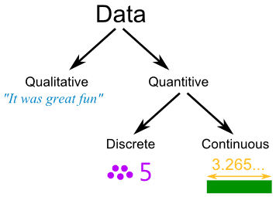
What is Data?
A collection of fact!!!

Slide 3
What is Data Analysis
Data analysis is about manipulating and presenting results
Data need to be organised, summarised, and analysed in order to draw/infer conclusion
Commonly used approaches or tools
Statistics
Models
Standards

Slide 4
What is Statistics?
The science of collecting and analyzing data

Slide 5
Sources of data
Lab Experimentation
Survey
Census
Theoretical analysis
Numerical analysis – software
Other researchers data

Slide 6
Classes of experiment/data collection
Estimation of parameter mean values
Estimation of parameter variability
Comparison of parameter mean values
Comparison of parameter variability
Modeling the dependence of dependant variable on several quantitative and qualitative independent variables

Slide 7
Data checking
Before doing data analysis and interpretation :
Watch for invalid data using whatever data checking procedure
Weeding out of ‘bad’ data is to be done continuously throughout data gathering process
Bad data can bias results and interpretation
Repeat data gathering or experimentation if there exist suspicious data.

Slide 8
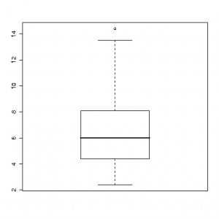
Outliers
An outlier is an observation that lies outside the overall pattern of the data distribution.
There are several statistically robust methods for outlier detection, an idea analogous to measuring onset latencies, one of which is the box plot

Slide 9
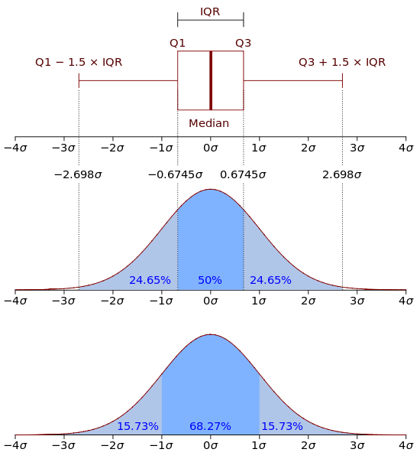
Box Plot Method

Slide 10
Trial Test
Do a simple trial test, so that :
to ensure that all parts in the testing set-up function well
to determine the range of measurement to be taken
to anticipate the time taken for each step in the experiment
to see the error

Slide 11
Error (Uncertainty)
When writing a measurement result with ± e, it doesn’t mean that we have done error.
It is uncertainty due to the limit of equipment and technique of experiment
Case I:
Theory said, deflection = 5.0 mm. In the experiment, deflection = 5.5 mm. Is it meant that the theory wrong ? Ask first what is the error limit. If the error is ±0.75 mm, the theory is correct.

Slide 12
Error (Uncertainty)
Case II :
Two experimentalist doing measurement on the time taken for ……………. The first researcher give the result as 20.4 ± 0.4 sec. While the second researcher give 19.8 ± 0.8 sec.
Is their result contradict ?
No, their results is actually overlapping. However, we are more confident with the first one because the error is half of the second, meaning that the measurement is done very carefully.

Slide 13
ANALYSIS AND INTERPRETATION

Slide 14
Analysis and Interpretation
Statistical
Numerical – software
Graphical
Combination

Slide 15
Line charts
A powerful tool to explain results in terms of ‘cause and effect’
The horizontal x-axis is normally used for the independent variable (the cause or controlled variable)
The vertical y-axis is normally used for dependent variable (the effect).
To describe the development or progression
To show trends, response or behaviour in data

Slide 16
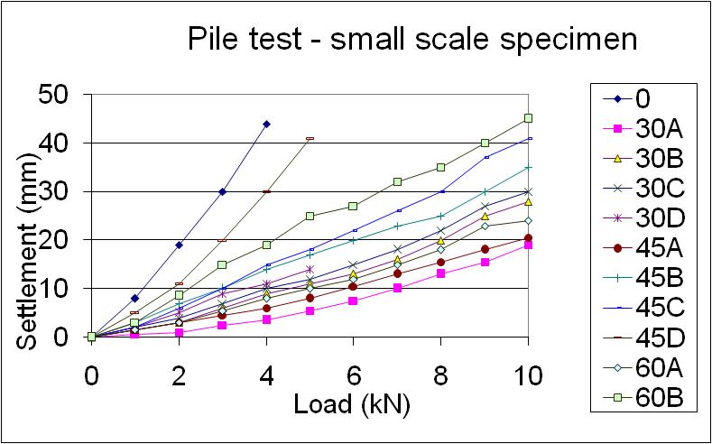
Line graph

Slide 17
Pie chart
Present data in segments
Convey simple and straightforward proportion of each category
Each segment is presented in terms of percentage
Can only be used with one data set

Slide 18
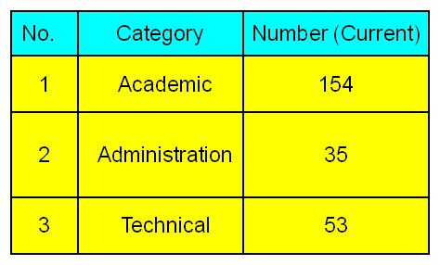
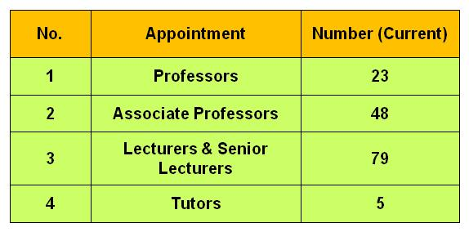
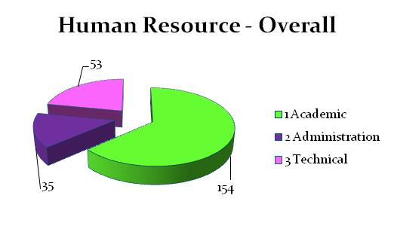
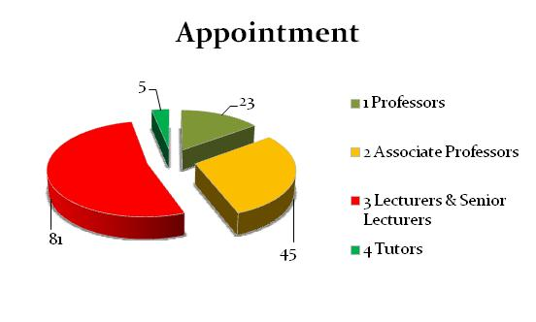
Academic Staff

Slide 19
Bar chart
An effective way of presenting frequencies
Common in reports of small scale research
The bar height represents quantity or amount
The number of bars represents the categories
Visually striking and simple to read

Slide 20
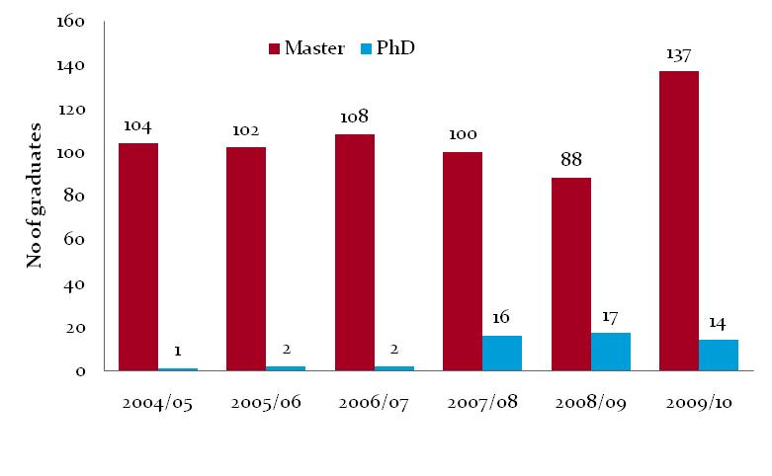
Bar chart

Slide 21
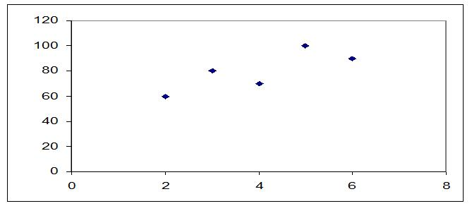
Scatter charts
Useful to present many data values
To show correlations between two variables
To draw conclusions about relationship in the data

Slide 22
CONSTRUCTION OF HISTOGRAM

Slide 23
WHAT IS HISTOGRAM?
A histogram is a graphical display of tabulated frequencies as well as a graphical version of a table that shows what proportion of cases fall into each of several or many specified categories.

Slide 24
HISTOGRAM
A histogram is the most important graphical tool for exploring the shape of data distributions (Scott, 1992).
The shape examined from the histogram puts the type of distribution into view.
A histogram can be constructed by plotting the frequency of observation against midpoint class of the data.

Slide 25
Number of class
where;
a : number of bin / class
n : number of observation (data)

Slide 27
TIPS!
If there are too few classes, it is difficult to see how the data vary.
If there are too many classes, then the table is less of a summary

Slide 28
SUMMARIZING DATA BY NUMERICAL MEASURES

Slide 29
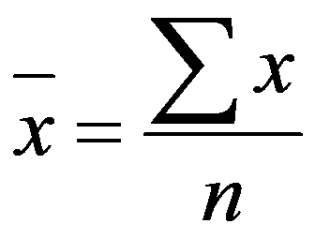
SAMPLE MEAN
The sample mean is defined as the sum of the observed variable, x divided by the number of observed values.

Slide 30
SAMPLE MEDIAN & MODE
The sample median of a variable x is defined as the middle value when the n sample observations of x are ranked in increasing order of magnitude
The sample mode of a variable x is defined as the value with the highest frequency

Slide 31
When to use mean, median & mode?
Mean – for normally distributed data (symmetrical distribution)
Median & Mode – for markedly skewed data

Slide 32
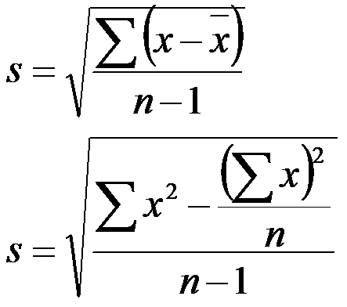
Sample Standard Deviation
Std measures the deviation of variable x from its sample mean.

Slide 33
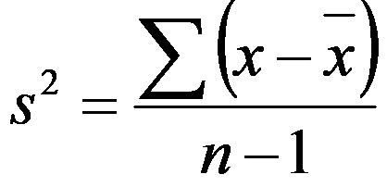
Other Measures of Variation
Variation = Std²

Slide 34
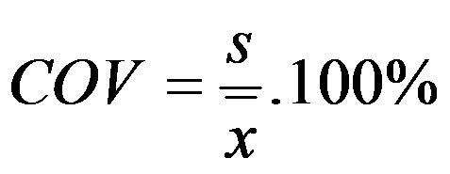
COEFFICIENT OF VARIATION
COV is expressed as a percentage and can be defined as a ratio of Std to sample mean. It is frequently used to compare the variabilities of two sets data.

Slide 35
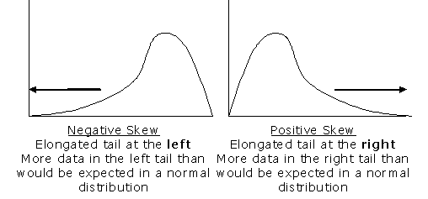
SKEWNESS
Measure the asymmetry of the probability distribution of a random variable.

Slide 36
SKEWNESS
Pearson’s skewness coefficient

Slide 37
KURTOSIS
Kurtosis (from the Greek word κυρτός, kyrtos or kurtos, meaning bulging) is a measure of the "peakedness" of the probability distribution of a real-valued random variable
Kurtosis is a measure of whether the data are peaked or flat relative to a normal distribution
Higher kurtosis means more of the variance is due to infrequent extreme deviations, as opposed to frequent modestly-sized deviations.

Slide 38
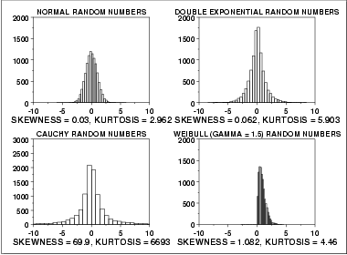

Slide 39
CONTINOUS PROBABILITY DISTRIBUTION
NORMAL DISTRIBUTION

Slide 40
NORMAL DISTRIBUTION
The normal distribution is the most important in Statistics.
It has a symmetrical bell shape, with most values concentrates towards the middle, a few extreme values, and it is unimodal.
It has two parameters, μ and σ

Slide 41
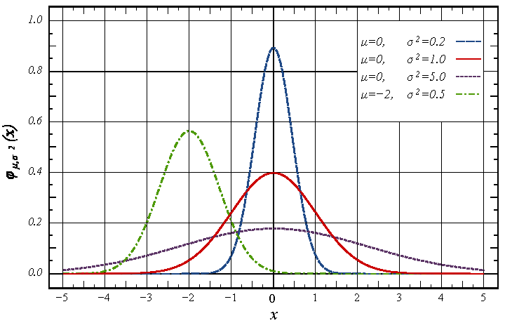
NORMAL DISTRIBUTION

Slide 42
NORMAL DISTRIBUTION
Approximately 68% of the area under any normal distribution curve lies within one standard deviation of the mean.
Approximately 95% of the area under any normal distribution curve lies within two standard deviation of the mean.
Approximately 99% of the area under any normal distribution curve lies within one standard deviation of the mean.

Slide 43
Normal Distribution
Total area under the curve = 1.0 or 100%
The area under the curve :
within 1 std. deviation = 0.68 or 68%;
within 2 std deviation = 95%
within 3 std deviation = 99.7
68%
−σ
σ
95%
−2σ
2σ
99.7%
−3σ
−2σ
−σ
σ
2σ
3σ
−3σ
3σ

Slide 44
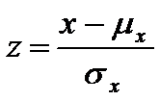
NORMAL DISTRIBUTION

Slide 45
STANDARD NORMAL DISTRIBUTION
A standard normal distribution is a normal distribution with zero mean and one unit variance , given by the probability function and distribution function

Slide 46
SAMPLES AND POPULATION
STATISTICAL INFERENCE

Slide 47
INTRODUCTION
Statistical Inference is drawing a conclusions from sample data about the larger populations from which the samples are drawn.
A population is the whole set of a measurements or counts about which we want to draw a conclusion.
A sample is a subset of the population, a set of some of the measurements or counts which comprise the population.

Slide 48
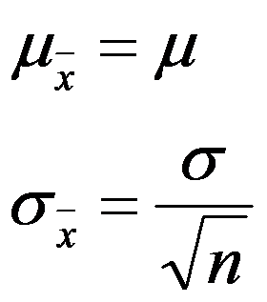
CONNECTION
What is the connection between the mean, std and shape of the parent population and the mean, std and shape of the sampling distribution of the sample mean?

Slide 49
CONFIDENCE INTERVAL ESTIMATION

Slide 50
INTERVAL ESTIMATE
Statistical theory indicates that the size of the error term and hence the width of the interval, depend on;
The sample size
The variability of the variable
The level of confidence we wish to have that the population mean does in fact lie within the specified interval

Slide 51
95% CONFIDENCE INTERVAL
It means that on 95% of occasions when such intervals are calculated the population mean will actually fall inside the interval we have calculated from the sample data.
On the other 5% of occasions, it will fall outside the interval.

Slide 52
95% CONFIDENCE INTERVAL

Slide 53
95% CONFIDENCE INTERVAL FOR SMALL SAMPLE SIZE

Slide 54
Student’s Distribution
The Student's t-distribution (or also t-distribution), in probability and statistics, is a probability distribution that arises in the problem of estimating the mean of a normally distributed population when the sample size is small.
It is the basis of the popular Student's t-tests for the statistical significance of the difference between two sample means, and for confidence intervals for the difference between two population means.

Slide 55
Why use t-distribution?
Confidence intervals and hypothesis tests rely on Student's t-distribution to cope with uncertainty resulting from estimating the standard deviation from a sample, whereas if the population standard deviation were known, a normal distribution would be used.

Slide 56
RELIABILITY TESTING
Questionnaire and Survey Data

Slide 57
CRONBACH’S ALPHA (Α) COEFFICIENT
Cronbach's alpha is a measure of internal consistency, that is, how closely related a set of items are as a group.
In theory this is the proportion of the observed data that can be attributed to the population data
This method is used to measure the internal consistency of multiple-item measurements, representing the averaged correlation between the items.

Slide 58
CRONBACH’S ALPHA (Α) COEFFICIENT
Internal consistency is typically a measure based on the correlations between different items on the same test (or the same subscale on a larger test).
It measures whether several items that propose to measure the same general construct produce similar scores.
For example, if a respondent expressed agreement with the statements "I like to ride bicycles" and "I've enjoyed riding bicycles in the past", and disagreement with the statement "I hate bicycles", this would be indicative of good internal consistency of the test.

Slide 59
CRONBACH’S ALPHA (Α) COEFFICIENT
As multiple-item measurements are in theory repeated measurements of the same thing, the coefficient represents the reliability of the overall measurement.
A "high" value of alpha is often used (along with substantive arguments and possibly other statistical measures) as evidence that the items measure an underlying (or latent) construct.
However, a high alpha does not imply that the measure is unidimensional.
Spearman-Brown coefficients is another reliability testing method

Slide 60
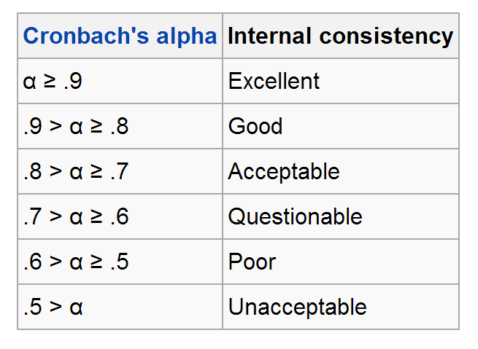
SOURCE: George, D., & Mallery, P. (2003). SPSS for Windows step by step: A simple guide and reference. 11.0 update (4th ed.). Boston: Allyn & Bacon

Slide 61
HYPOTHESIS TESTING
ANOTHER BRANCH OF STATISTICAL INFERENCE

Slide 62
HYPOTHESIS TESTING
A hypothesis is a conjecture about a population parameter. This conjecture may or may not be true.
An educated guess based on theory and background information
Hypothesis Testing is a process of using sample data and statistical procedures to decide whether to reject or not reject a hypothesis (statement) about a population parameter value.

Slide 63
Hypothesis - example
Situation A: A researcher is interested in finding out whether a new medicine will have any undesirable side effects on the pulse rate of the patient. Will the pulse rate increase, decrease or remain unchanged. Since the researcher knows the pulse rate of the population under study is 82 beats per minute, the hypothesis will be
Ho : μ = 82 (remain unchanged)
H1 : μ ≠ 82 (will be different)
This is a two-tailed test since the possible effect could be to raise or lower the pulse

Slide 64
Hypothesis - example
Situation B: A chemist invents an additive to increase the life of an automobile battery. The mean life time of ordinary battery is 36 months. The hypothesis will be:
Ho : μ ≤ 36
Ha : μ > 36
The chemist is interested only in increasing the lifespan of the battery. His alternative hypothesis is that the mean is larger than 36. Therefore the test is called right-tailed, interested in the increase only.

Slide 65
Hypothesis - example
Situation C: A contractor wishes to lower heating bill by using a special type of insulation in house. If the average monthly bill is RM100, his hypothesis will be
Ho : μ ≥ RM 100
H1 : μ < RM 100
This is a left-tailed test since the contractor is only interested in reducing the bill

Slide 66
HYPOTHESIS TEST STEPS
Decide on null hypothesis, H0.
Decide on an alternative hypothesis, H1
Decide on a significance level
Calculate the appropriate test statistic, using the sample data
Find from tables the appropriate tabulated test statistic
Compare the calculated and tabulated test statistics, and decide whether to reject the null hypothesis, H0.
State a conclusion, after checking to see whether the assumptions required for the test in question are valid.

Slide 67
HYPOTHESIS
The null hypothesis generally expresses the idea of no difference.
The alternative hypothesis, which we denote by H1, expresses the idea of some difference.
Alternative hypothesis may be one-sided (greater or less than) or two-sided (not equal to)

Slide 68
Test of significance
A z-test is used for testing the mean of a population versus a standard, or comparing the means of two populations, with large (n ≥ 30) samples whether you know the population standard deviation or not. It is also used for testing the proportion of some characteristic versus a standard proportion, or comparing the proportions of two populations.
Example: Comparing the average engineering salaries of men versus women.
Example: Comparing the fraction defectives from 2 production lines.

Slide 69
Test of significance
A t-test is used for testing the mean of one population against a standard or comparing the means of two populations if you do not know the populations’ standard deviation and when you have a limited sample (n < 30). If you know the populations’ standard deviation, you may use a z-test.
Example: Measuring the average diameter of shafts from a certain machine when you have a small sample.
An F-test is used to compare 2 populations’ variances. The samples can be any size. It is the basis of ANOVA.
Example: Comparing the variability of bolt diameters from two machines.

Slide 70
WHAT IS A SIGNIFICANCE LEVEL
A significance level of 5% is the risk we take in rejecting the null hypothesis.

Slide 71
CHI-SQUARE GOODNESS OF FIT TEST
Chi-square value or can be denoted as χ² provided a good test to fit the hypothesis distribution with the real one.
The observed data can be grouped into class interval and observed frequency, O.
Suppose that for a group of observation data, a distribution can be specified for any whatsoever type by making hypothesis based on the histogram shape.

Slide 72
CHI-SQUARE GOODNESS OF FIT TEST
For each class of the grouped data, the expected frequency for each class can be estimated on the basis of the hypothecal distribution.
It can be carried out by multiplying the reliability density function of hypothesis distribution for each class interval with number of data, n to obtain expected frequency, E.
The χ² then can be estimated for each class using the given formula;

Slide 73
CHI-SQUARE GOODNESS OF FIT TEST
All single value of χ² for each class can be summed up.
The hypothesis can be verified by comparing the estimated χ² with the critical value for χ² statistic from Chi-square statistic table
If the critical value for χ² statistics is less than the calculated value, the proposed distribution will be rejected.
The χ² value from the statistic table can be determined based on level of significance

Slide 74
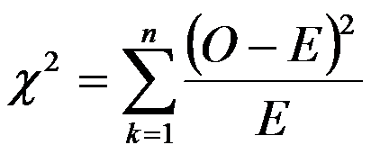
ESTIMATED CHI-SQUARE
χ² = chi-square value.
E = expected value.
O = observed value.
k = degree of freedom.
n = number of class

Slide 75
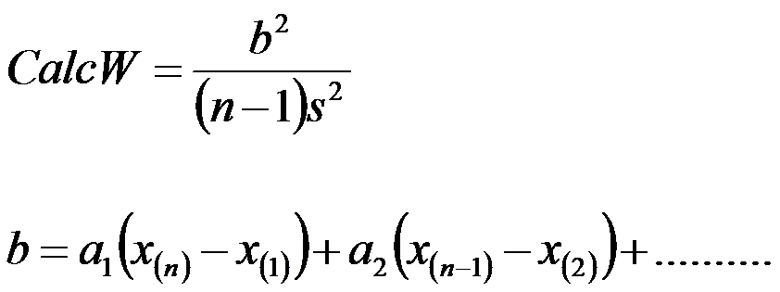
THE SHAPIRO-WILK TEST

Slide 76
LINEAR REGRESSION
SINGLE AND MULTIPLE REGRESSION

Slide 77
CORRELATION COEFFICIENT, r
Pearson’s Sample Correlation Coefficient, r, is used to measure the strength and direction of the association between two numerical paired variables
r can be any value from –1 to +1.
The closer r is to one (in magnitude) the stronger the linear association is.
If r equals zero, then there is no linear association between the two variables.

Slide 78
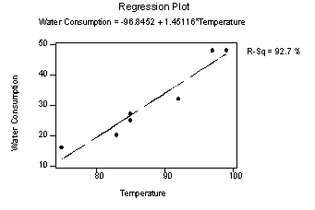
LINEAR REGRESSION
Linear regression give estimate / predict the outcome of one variable upon another dependent variable. based on linear relationship.

Slide 79
MULTIPLE REGRESSION
Multiple Regression is an extension of simple regression.
Simple regression has only one independent (explanatory) variable.
Multiple Regression fits a model for one dependent (response) variable based on more than one independent (explanatory) variables.

Slide 80
MULTIPLE REGRESSION

Slide 81
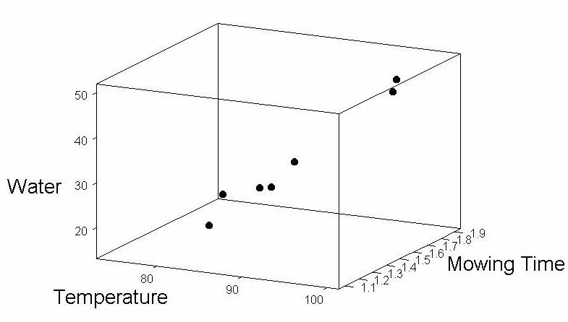
VISUAL REPRESENTATION

Slide 82
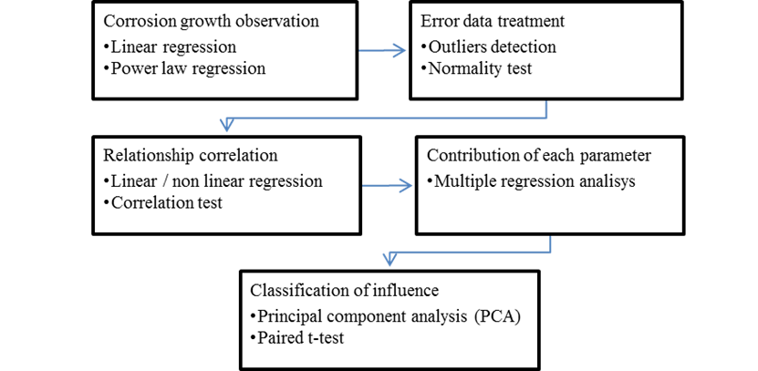
EXAMPLE OF DATA ANALYSIS FLOW

Slide 83
Normality Test
Normality is one of the important underlying assumptions for the many statistical tests. Some of the statistical test have the limitation which the data set must follow a normal distribution.
If this condition is not satisfied, the test result may give a wrong finding. The purpose of normality test is to test the degree of normality of variables.
The normality test can be carried out using Shapiro-Wilk (S-W) and Kolmogorov-Smirnov (K-S) test .

Slide 84
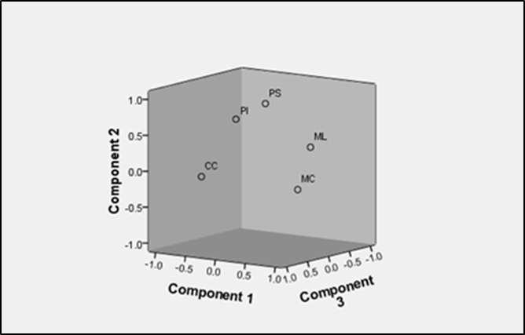
Principal component analysis (PCA)
Principal component analysis (PCA) is widely used in statistics, signal processing and neural computing to reduce the number of variables in database and to detect structure in the relationships between variables, that is to classify variables

